Slide 1

New technologies in your life
→ A Connected World :

Slide 2


Virtual smartphone
Why would you need a physic smartphone ?
While the puce in your mind make you see holograms !

Slide 3
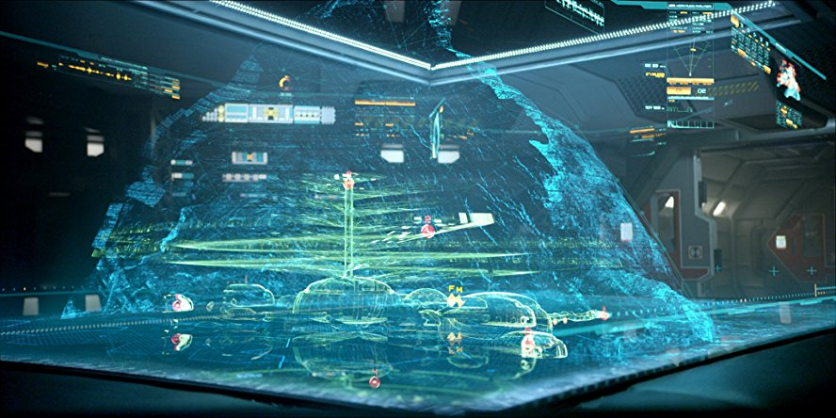
Artificial reality
Let's play video games !
A console ? A joystick ? So out-of-date !
Welcome to the future !

Slide 4
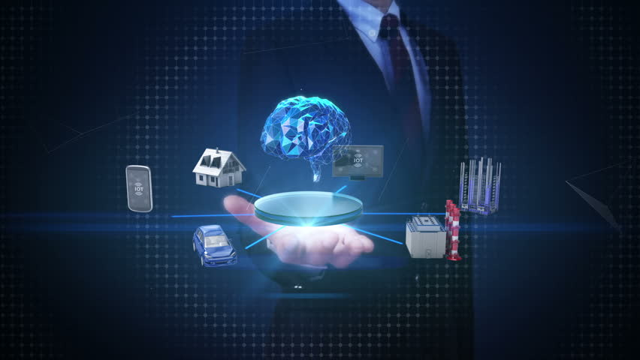
Connected home
Buttons for the light ? What an old idea !
Let your thought do it for you ! Does anyone want a coffee ? In 2142 it would already be ready.

Slide 5
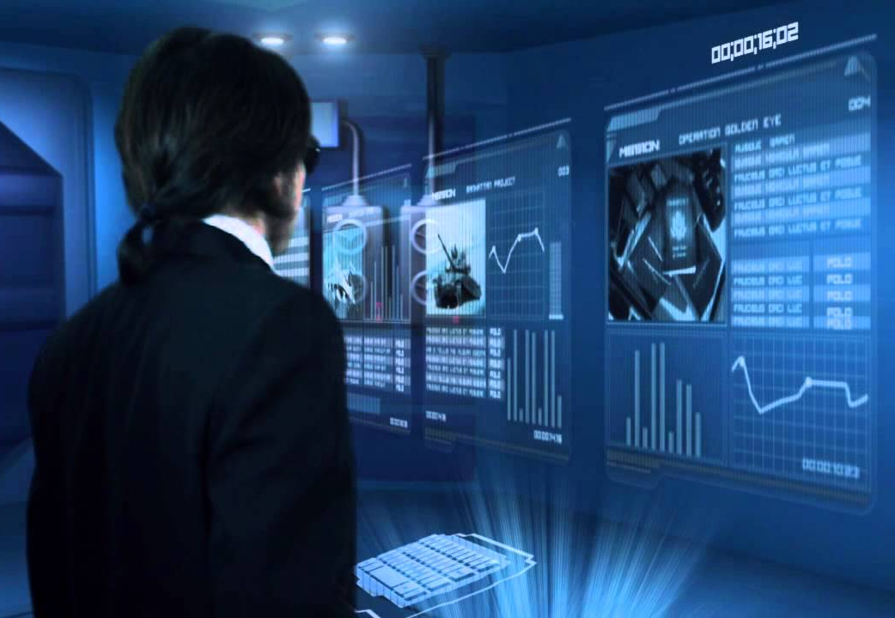
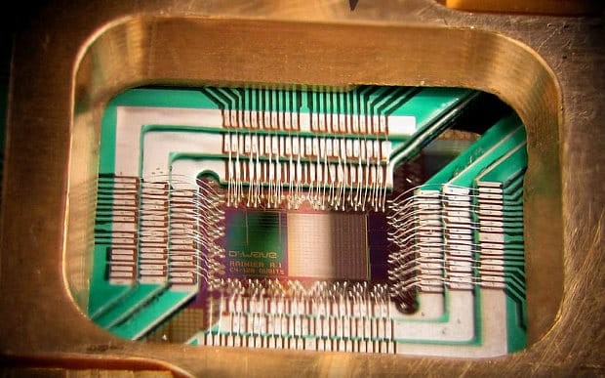
Holographic quantum laptop
Combine the beauty of holograms with the power of quantum to get the bests computers ever !

Slide 6

Holographic quantum laptop
AND PLAY
OVER 8000 FPS !

Slide 7
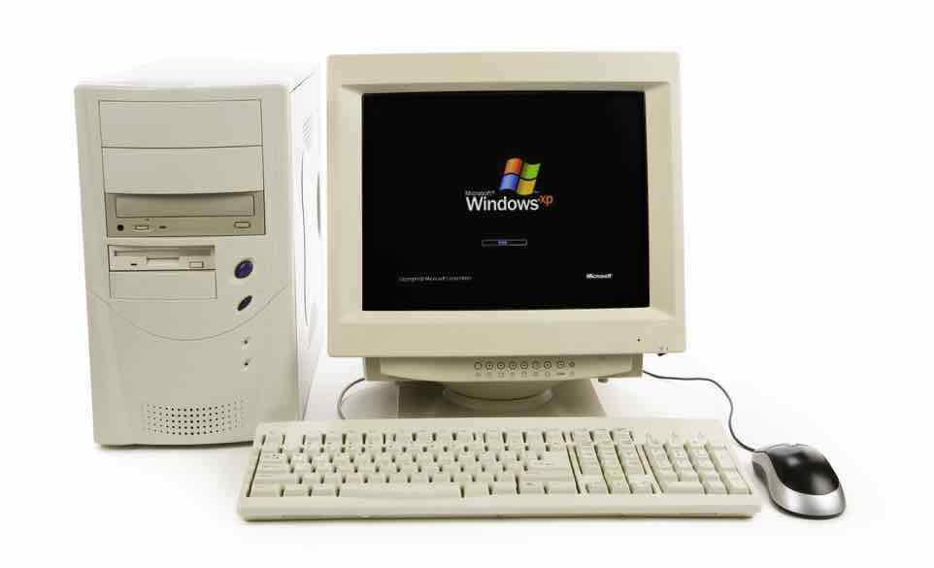
Thank you !
Any questions ?
Linux
...

